Slide 1
Notes:
These were the first 4 topics (benzodiazepines, barbituates, z-drugs, miscellaneous hypnotics) we had sent to Dr. Beleh. I was thinking maybe we should combine z-drugs and miscellaneous hypnotics into one “topic” since there isn’t much information. Then the 4th topic can be anticonvulsants!!
Tool 1 (Angela) - “SAR module.” Include basic SAR requirements for each and then practice problems like we have on exams. For example, where we have to pick the most active compound given 3 compounds or there is change to a compound and you have to say if the change increases or decreases activity. Also include some SAR case based questions and metabolism questions where student has to pick correct answer based on compound structure.
Tool 2 (Kristen)- MOA and key features of the drug classes? Name and function from picture of molecule. We’ve had to do this on past exams and this will help with general picture of drugs. Matching could be an option but on exams we had to produce the answer so maybe it should be fill in the blank
^^maybe since my section above is focusing on the drug structures, you can have your answer choices be the drug name instead of the structure just so there is more variety.
Tool 3 (Codie) - Printable/Downloadable worksheet -> Can be all pharmacology or have column for some SAR
OR….
Pharmacology case-based questions: Each answer will provide input as to why the selected choice was correct or not.
Notes:
I think we should have something printable
I agree i think you should go with the worksheet, codie. But like you said on your example slide, i think there should also be a filled in worksheet option available. It would be a nice answer key type thing to have and that doesn’t necessarily need to be printable.

Slide 2
Benzodiazepines

Slide 3
Tool 1- Structure Activity Relationship (SAR) Module
Module Design Overview:
The module will be designed as one screen that has 3 clickable tabs at the top, which would say:
1. SAR Requirements
Students will be able to click on the arrows on the compound below or on the letters in the rings
As the student clicks on each spot, the SAR requirement will be displayed next to the compound
2. Drug Class Examples
Drug structures will be displayed with SAR requirements circled or highlighted in corresponding colors with the SAR requirement tab
3. Practice Problems
Format described with each question

Slide 4

Tool 1- Structure Activity Relationship (SAR) Module
Tab 1: Benzodiazepines SAR requirements
Ring A→ Pi-Pi stacking with BZR
C7→ EWG increases activity
Ring B→ H-bond acceptor (O, N, S) or N-heterocycle required
1,2 annelation (N-heterocycle) increases affinity for BZR
N1→ methyl group preferred; bulky group decreases activity because it prevents binding to BZR
C3→ OH group eliminates first pass metabolism as the hydroxyl acts as a “handle” for conjugation.
Ring C→ Hydrophobic interaction with BZR
C4→ steric repulsion occurs with para substituent
C2→ F or Cl substitution reduces aromatic hydroxylation and improves half-life

Slide 5
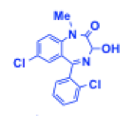
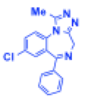
Tool 1- Structure Activity Relationship (SAR) Module
Tab 2: Drug Class Examples
Lorazepam Alprazolam

Slide 6
Tool 1- Structure Activity Relationship (SAR) Module
Tab 3: PRACTICE PROBLEM design- Would the following change to the compound increase or decrease activity at the BZR?
Have a picture of a compound and then another picture of the compound with one change made
Answer choices: increase or decrease activity
If right answer is selected→ explanation of why the answer is correct is shown next to the compound
If wrong answer is selected→ direct student back to the basic SAR requirement tab for review (no explanation is shown, student must go back and review SAR requirements to move on in the practice problems tab)

Slide 7
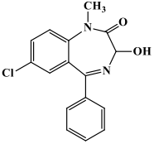
Tool 1- Structure Activity Relationship (SAR) Module
Tab 3: PRACTICE PROBLEM- Would the following change to the compound increase or decrease activity?
CORRECT ANSWER: DECREASE
Addition of a bulky group at N1 prevents binding to the BZR; methyl group is preferred
tert-Butyl
Click on either:
INCREASE
OR
DECREASE

Slide 8
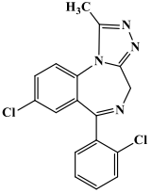
Tool 1- Structure Activity Relationship (SAR) Module
Tab 3- PRACTICE PROBLEM: Would the following change to the compound increase or decrease activity?
CORRECT ANSWER: INCREASE
Addition of Cl to position 2 reduces aromatic hydroxylation (phase one P450 metabolism) and increases half-life
Click on either:
INCREASE
OR
DECREASE

Slide 9
Tool 1- Structure Activity Relationship (SAR) Module
Tab 3- PRACTICE PROBLEM design: Which of these 3 compounds would be the best benzodiazepine (for the specific situation given)?
Have 3 pictures of different compounds
Student can click any of the 3 compounds
If right compound is selected→ explanation of why the answer is correct is shown
If wrong compound is selected→ direct student back to the basic SAR requirement tab for review (no explanation is shown, student must go back and review SAR requirements to move on in the practice problems tab)

Slide 10
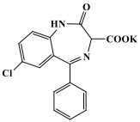
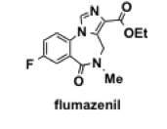
Tool 1- Structure Activity Relationship (SAR) Module
Tab 3- PRACTICE PROBLEM: Which of these 3 compounds would be the best benzodiazepine for use as a hypnotic? Click on any compound:
CORRECT ANSWER: compound 1 (temazepam)
Best choice for a hypnotic as it already has the hydroxyl handle (position 3) so it is quickly metabolized to an inactive metabolite by conjugation; thus it has a short elimination half-life, which is ideal for hypnotics

Slide 11
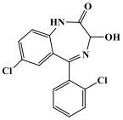

Tool 1- Structure Activity Relationship (SAR) Module
Tab 3- PRACTICE PROBLEM: Which of these 3 compounds would be the best benzodiazepine for use as an anxiolytic? Click on any compound:
CORRECT ANSWER: compound 2 (chlorazepate)
Best choice for an anxiolytic. The compound is slowly absorbed because it has a carboxylic acid that must be cleaved first (like a prodrug) and it is metabolized to an active metabolite; thus it has a long elimination half-life (40-50 hr), which is ideal for anxiolytics

Slide 12
Tool 1- Structure Activity Relationship (SAR) Module
Tab 3- PRACTICE PROBLEM design: Predict if the metabolites will be active or inactive
Have a picture of a compound with its metabolites
Answer choices for each metabolite: active or inactive
Correct answer will be shown once selected

Slide 13
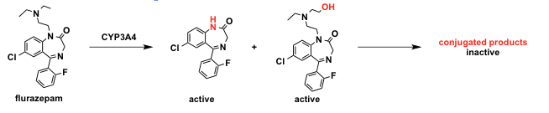
Tool 1- Structure Activity Relationship (SAR) Module
Tab 3: PRACTICE PROBLEM: Predict if the metabolites will be active or inactive
Click either:
Active
or
Inactive?
ANSWER:
Inactive
Click either:
Active
or
Inactive?
ANSWER:
Active
Click either:
Active
or
Inactive?
ANSWER:
Active

Slide 14
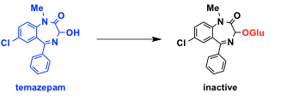
Tool 1- Structure Activity Relationship (SAR) Module
Tab 3: PRACTICE PROBLEM- Predict if the metabolites will be active or inactive
Click either:
Active
or
Inactive?
ANSWER:
Inactive
Would this be an ideal hypnotic or anxiolytic? (click either)
ANSWER: hypnotic

Slide 15
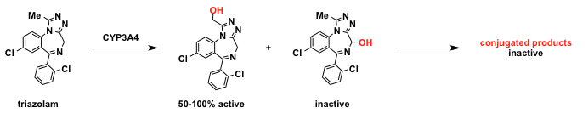
Tool 1- Structure Activity Relationship (SAR) Module
Tab 3: PRACTICE PROBLEM- Predict if the metabolites will be active or inactive
Click either:
Active
or
Inactive?
ANSWER:
Inactive
Click either:
Active
or
Inactive?
ANSWER:
Active
Click either:
Active
or
Inactive?
ANSWER:
Inactive
Would this be an ideal hypnotic or anxiolytic? (click either)
ANSWER: hypnotic

Slide 16
Tool 2 - Mechanism of Action and Indications
Module Design Overview:
The module will be designed as one screen, that has fill in the blank statements, with a drop down menu of ~4 possible choices. After all are filled in, the student submit for answers/explanations, and print the completed correct copy for their own studying
1. Mechanism of Action/Indication characteristics
Students will have examples of drug structures from the class on the screen and will know what drug class they are working on
The drop down menu will have possible fill in the blank choices
The goal of the fill in the blanks will to have a summary of where and how the drug class acts, and why it works for its indications
2. Side effects/Contraindications
If there are significant side effects or contraindications to specific drugs in the class or to the drug class in general, these can be addressed as well as statements with blanks to be filled in.

Slide 17
Tool 2 - examples
Fill in blank statements with drop down menu
Benzodiazepines act at the ________ receptor to increase ____ channel opening
Drop down menu options: benzodiazepine, GABA, glutamate
2nd drop down menu options: Ca2+, Na+, Cl-
Inhibitors or activators of ______ will affect benzodiazepines
Drop down menu options: CYP2B6, CYP3A4, CYP2C9

Slide 18
Tool 2 - examples
Fill in blank statements with drop down menu (more drug specific)
Diazepam and ______ are useful to treat withdrawal from _________
The first blank menu: clonazepam, triazolam, midazolam, lorazepam
The second blank will have a drop down menu with abused drugs such as marijuana, opioids, alcohol, and nicotine, with alcohol being the answer
Lorazepam, ________, and ___________ are all used to treat status epilepticus
Either blank will have clonazepam, diazepam, midazolam as options
Notes:
Diazepam and ___lorazepam___ are useful to treat withdrawal from ___alcohol______
The first blank menu: clonazepam, triazolam, midazolam, lorazepam
The second blank will have a drop down menu with abused drugs such as marijuana, opioids, alcohol, and nicotine, with alcohol being the answer
Lorazepam, _____diazepam___, and ____clonazepam_______ are all used to treat status epilepticus
Either blank will have clonazepam, lorazepam, midazolam as options

Slide 19
Tool 2 - examples
2. Side effects/Contraindications
When a benzodiazepine is taken for sleep, it can cause _______ due to its long elimination half life
Drop down menu: headache, insomnia, grogginess, amnesia
A serious and unusual side effect of a benzodiazepine is ______
Drop down menu: Induction of P450s, G6P deficiency, amnesia
Tolerance develops to ________ but more rarely to _________
Each drop down can have sedative effects, anxiolytic effects, anesthetic effects
Notes:
2. Side effects/Contraindications
When a benzodiazepine is taken for sleep, it can cause ___grogginess____ due to its long elimination half life
Drop down menu: headache, insomnia, grogginess, amnesia
A serious and unusual side effect of a benzodiazepine is __amnesia____
Drop down menu: Induction of P450s, G6P deficiency, amnesia
Tolerance develops to ____sedative____ but more rarely to _____anxiolytic____
Each drop down can have sedative effects, anxiolytic effects, anesthetic effects

Slide 20
Tool 2 - examples
2. Side effects/Contraindications (more drug specific)
Patient AB has been prescribed a benzodiazepine and another medication for OCD. AB feels excessively sleepy and has noticed her balance is off. AB is probably taking diazepam and _______
Bupropion, nortriptyline, fluoxetine
This benzodiazepine is best suited for elderly individuals with liver damage: ________
Lorazepam, diazepam, clonazepam
Notes:
Patient AB has been prescribed a benzodiazepine and another medication for OCD. AB feels excessively sleepy and has noticed her balance is off. AB is probably taking diazepam and ___fluoxetine____
Bupropion, nortriptyline, fluoxetine
This benzodiazepine is best suited for elderly individuals with liver damage: __lorazepam______
Lorazepam, diazepam, clonazepam

Slide 21
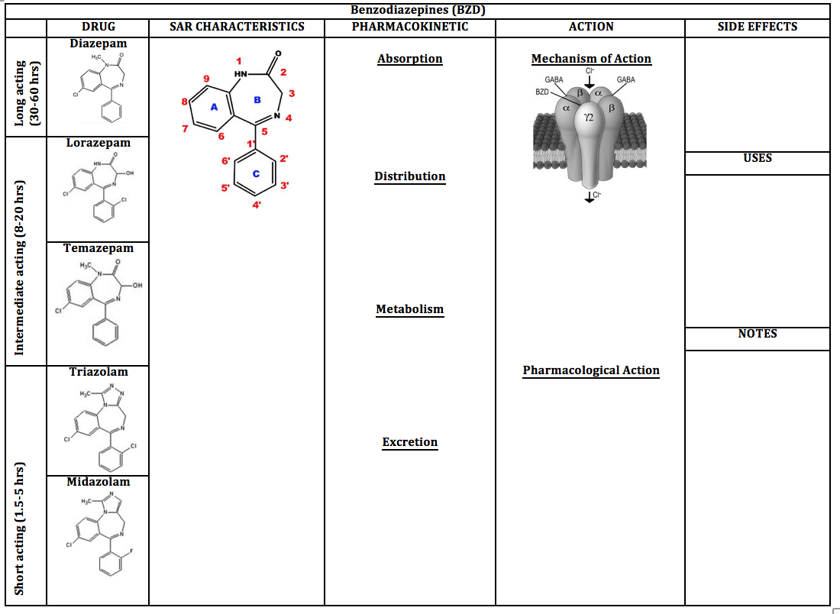
Tool 3 - Blank BZD worksheet
Notes:
Downloadable Links to PDF for printing

Slide 22
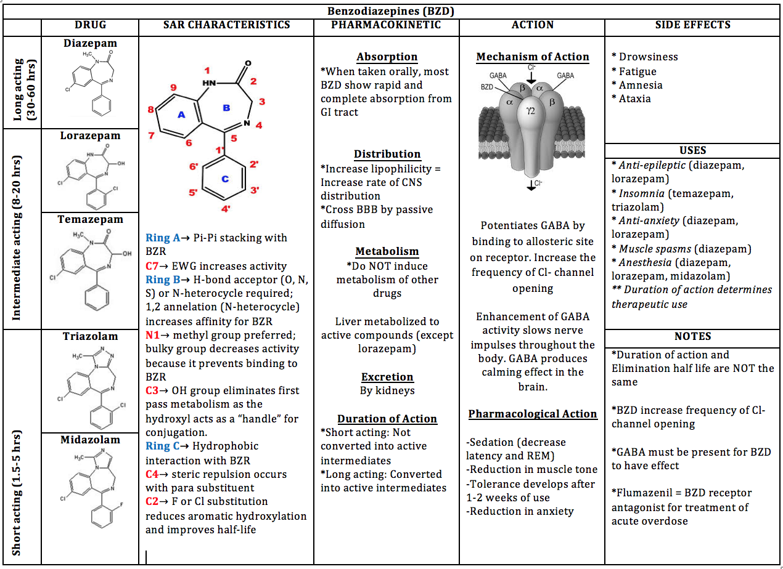
Tool 3 - Complete BZD worksheet for reference

Slide 23
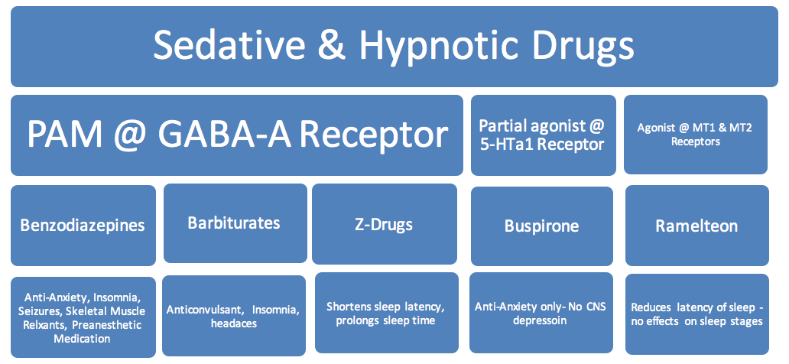

Slide 24
Barbiturates

Slide 25
Tool 1- Structure Activity Relationship (SAR) Module
Module Design Overview:
The module will be designed as one screen that has 3 clickable tabs at the top, which would say:
1. SAR Requirements
Students will be able to click on the arrows on the compound below or on the letters in the rings
As the student clicks on each spot, the SAR requirement will be displayed next to the compound
2. Drug Class Examples
Drug structures will be displayed with SAR requirements circled or highlighted in corresponding colors with the SAR requirement tab
3. Practice Problems
Format described with each question

Slide 26
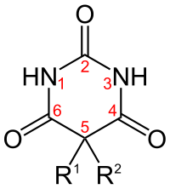
Tool 1- Structure Activity Relationship (SAR) Module
Tab 1: Barbiturates SAR requirements:
N1- must be a nitrogen and unsubstituted if N3 is substituted
Carbon group substitution will increase lipophilicity and more rapid onset of action
N3- must be a nitrogen and unsubstituted if N1 is substituted
Carbon group substitution will increase lipophilicity and more rapid onset of action
C2- changing C=O → C=S increases lipophilicity and more rapid onset of action
C4 and C6- must contain C=O
R1 and R2- bulky carbon groups increases lipophilicity and more rapid onset of action

Slide 27
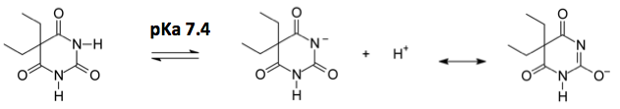

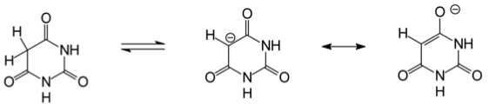
Tool 1- Structure Activity Relationship (SAR) Module
Barbiturates SAR requirements (continued):
5,5- disubstitution required for activity
Barbiturates can undergo enol-keto tautomerization, which gives them near neutral pkas (7.4). Less than 50% gets ionized, so good balance of solubility and CNS penetration
Without any substitution at position 5, the acidic hydrogen gets deprotonated
Resonance stabilization leads to lower pka (4) and 99% ionization occurs, so unable to penetrate the CNS

Slide 28
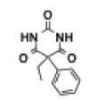
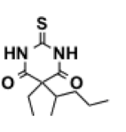
Tool 1- Structure Activity Relationship (SAR) Module
Tab 2: Drug Class Examples
Phenobarbital Thiopental

Slide 29
Tool 1- Structure Activity Relationship (SAR) Module
Tab 3: PRACTICE PROBLEM design- Would the following change to the compound increase or decrease activity of the barbiturate?
Have a picture of a compound and then another picture of the compound with one change made
Answer choices: increase or decrease activity
If right answer is selected→ explanation of why the answer is correct is shown
If wrong answer is selected→ direct student back to the basic SAR requirement tab for review(no explanation is shown, student must go back and review SAR requirements to move on in the practice problems tab)

Slide 30
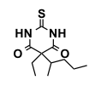

Tool 1- Structure Activity Relationship (SAR) Module
Tab 3: PRACTICE PROBLEM- Would the following change to the compound increase or decrease activity?
CORRECT ANSWER: DECREASE
Changing C=S to C=O decreases lipophilicity and onset of action
Click on either:
INCREASE
OR
DECREASE

Slide 31
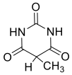
Tool 1- Structure Activity Relationship (SAR) Module
Tab 3: PRACTICE PROBLEM- Would the following change to the compound increase or decrease activity?
CORRECT ANSWER: INCREASE
5,5- disubstitution needed for activity in order for CNS penetration
Click on either:
INCREASE
OR
DECREASE

Slide 32
Tool 1- Structure Activity Relationship (SAR) Module
Tab 3: PRACTICE PROBLEM design- Which of these 3 compounds would be a CNS active barbiturate?
Have 3 pictures of different compounds
Student can click any of the 3 compounds
If right compound is selected→ explanation of why the answer is correct is shown
If wrong compound is selected→ direct student back to the basic SAR requirement tab for review (no explanation is shown, student must go back and review SAR requirements to move on in the practice problems tab)

Slide 33

Tool 1- Structure Activity Relationship (SAR) Module
Tab 3: PRACTICE PROBLEM- Which of these 3 compounds would be a CNS active barbiturate? Click on any compound:
CORRECT ANSWER: Compound 3 (phenobarbital)
5,5- disubstitution and weak acid (N1 or N3 must be unsubstituted) are required for activity in order for CNS penetration
H

Slide 34
Tool 1- Structure Activity Relationship (SAR) Module
Tab 3- PRACTICE PROBLEM design: Predict possible metabolites
Have a picture of a compound and student is able to click on different areas of compound
Answer choices for each part of the compound
Correct answer will be shown once selected with the type of metabolite that would form
If wrong part of the compound is selected→ INCORRECT will be displayed

Slide 35
Tool 1- Structure Activity Relationship (SAR) Module
Tab 3- PRACTICE PROBLEM design: Predict possible metabolites
Click anywhere on the compounds
ANSWER:
Hydroxylation on the benzene ring
ANSWER:
Desulfurization C=S→ C=O

Slide 36
Tool 2
Module Design Overview:
The module will be designed as one screen, that has fill in the blank statements, with a drop down menu of ~4 possible choices. After all are filled in, the student submit for answers/explanations, and print the completed correct copy for their own studying
1. Mechanism of Action/Indication characteristics
Students will have examples of drug structures from the class on the screen and will know what drug class they are working on
The drop down menu will have possible fill in the blank choices
The goal of the fill in the blanks will to have a summary of where and how the drug class acts, and why it works for its indications
2. Side effects/Contraindications
If there are significant side effects or contraindications to specific drugs in the class or to the drug class in general, these can be addressed as well as statements with blanks to be filled in.

Slide 37
Tool 2 examples
Higher doses of barbiturates bind ______ receptors in teh cerebellum causing the side effect of ________
Drop down menu options: GABAa, GABAb, glutamate
Drop down menu options: Ataxia, amnesia, sedation
The long half life of barbiturates causes a _____________ effect, while the short half life or abrupt discontinuation causes ____________ effect
Drop down menu options: Hangover, rebound

Slide 38
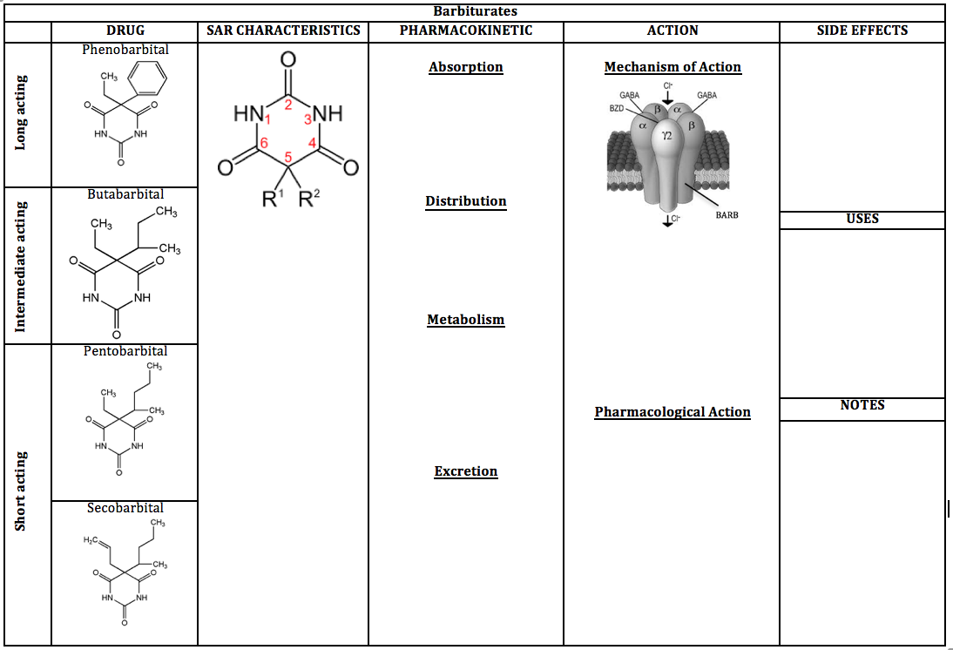
Tool 3 - Blank Barb Sheet

Slide 39
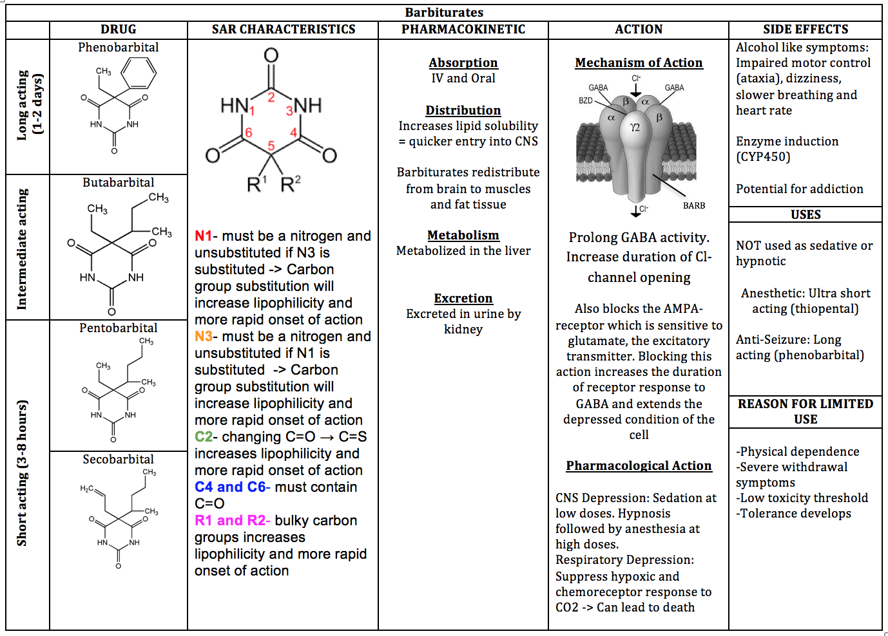
Tool 3 - Complete Barb worksheet for reference

Slide 40
Z-Drugs/ Miscellaneous Hypnotics

Slide 41
Tool 1- Structure Activity Relationship (SAR) Module
Module Design Overview:
The module will be designed as one screen that has 2 clickable tabs at the top, which would say:
1. SAR Requirements
Students will be able to click on the arrows on the compound below or on the letters in the rings
As the student clicks on each spot, the SAR requirement will be displayed next to the compound
2. Practice Problems
Format described with each question

Slide 42
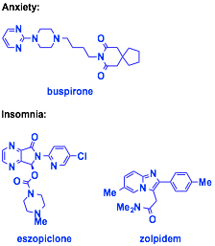

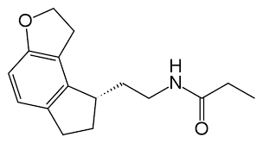
Tool 1- Structure Activity Relationship (SAR) Module
Tab 1: SAR Requirements:
None present
Z-Drugs: circled parts of the structure are helpful to associate with this class
Ramelteon

Slide 43
Tool 1- Structure Activity Relationship (SAR) Module
Tab 2: PRACTICE PROBLEM- SAR Clinical Case Study
Present a multi-question case with answer choices given as the compound structure
Student can click any of the 3 compounds
If right compound is selected→ explanation of why the answer is correct is shown
If wrong compound is selected→ direct student back to the beginning of the practice problem

Slide 44

Tool 1- Structure Activity Relationship (SAR) Module
PRACTICE PROBLEM: SAR Clinical Case Study
LM is 25-year old female suffering from anxiety and insomnia.
What one compound would be best to treat both her anxiety and insomnia?
ANSWER: Compound 2 (benzodiazepine)

Slide 45
Tool 1- Structure Activity Relationship (SAR) Module
PRACTICE PROBLEM: SAR Clinical Case Study
LM is 25-year old female suffering from anxiety and insomnia.
LM’s boyfriend takes one of these hypnotics for insomnia and it helps keep him asleep with no hangover effects in the morning. LM decides to take one of his pills, but in the morning she is still sleepy. Which of these compounds did she take and why is she still experiencing effects in the morning?
ANSWER: Compound 1 (zolpidem); women metabolize slower

Slide 46
Tool 1- Structure Activity Relationship (SAR) Module
PRACTICE PROBLEM: SAR Clinical Case Study
LM is 25-year old female suffering from anxiety and insomnia.
LM has had abuse disorders in the past. Which of these compounds would be safest to use to treat her insomnia?
ANSWER: Compound 3 (ramelteon); not a scheduled drug

Slide 47
Tool 2 - Mechanism of Action and Indications
Module Design Overview:
The module will be designed as one screen, that has fill in the blank statements, with a drop down menu of ~4 possible choices. After all are filled in, the student submit for answers/explanations, and print the completed correct copy for their own studying
1. Mechanism of Action/Indication characteristics
Students will have examples of drug structures from the class on the screen and will know what drug class they are working on
The drop down menu will have possible fill in the blank choices
The goal of the fill in the blanks will to have a summary of where and how the drug class acts, and why it works for its indications
2. Side effects/Contraindications
If there are significant side effects or contraindications to specific drugs in the class or to the drug class in general, these can be addressed as well as statements with blanks to be filled in.

Slide 48
Tool 2 - examples
Eszopiclone binds to the ___________ receptor and potentiates _________
Drop down menu for first blank: barbituate, benzodiazepine, dopamine
Second blank: GABA, Glutamate, dopamine
_________ acts at the ________ receptor to help re-establish normal circadian rhythm
First blank menu: zolpidem, mirtazepine, ramelteon
Second blank menu: dopamine, serotonin, melatonin
_______ has the longest half life while _______ has the greatest potency
First blank: Zolpidem, Eszopiclone, Ramelteon
Second blank: same choices

Slide 49
Tool 2 - examples
________ is used to induce sleep and is metabolized slower by _________
Drop down menu options:Zolpidem, zaleplon, eszopiclone
Drop down menu options:Men, women
_______ is good therapy for when a patient is waking up in the middle of the night
Drop down menu options:Zaleplon, zolpidem, eszopiclone
________acts at both the a1 and a1 benzodiazepine receptor
Drop down menu options:Eszopiclone, zolpidem, zaleplon

Slide 50
Tool 2 - examples
Z drugs are not effective antianxiety drugs because they bind primarily to the ______ subunit of _______ receptors, not the ______ subunit.
First blank menu: benzodiazepine, alpha1, alpha2, beta
Second blank menu: GABA, benzodiazepine, barbiturate
Third blank menu: benzodiazepine, alpha1, alpha2, beta
Z drugs cause ________ primarily
Sedation, amnesia, anxiety relief

Slide 51
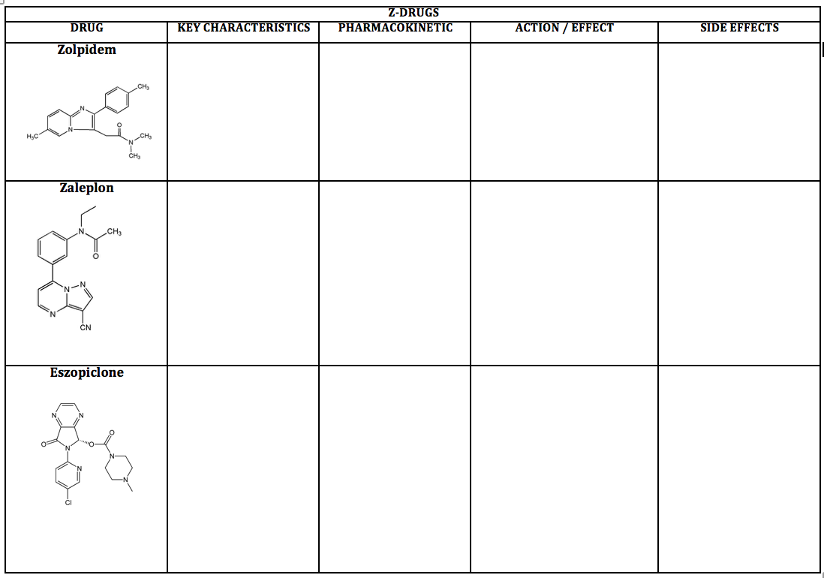
Tool 3 - Blank Z-Drugs worksheet

Slide 52
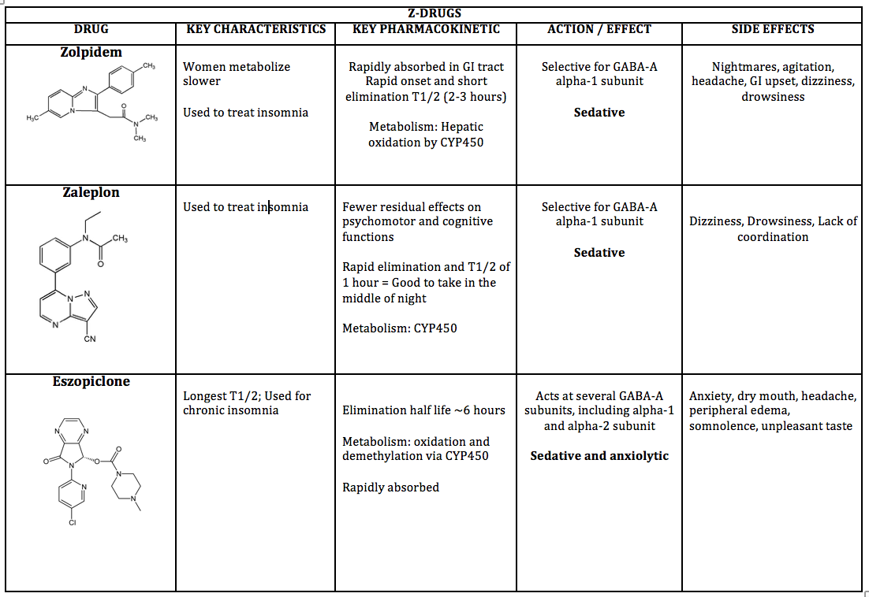
Tool 3 - Complete Z-Drug worksheet for reference

Slide 53
Anticonvulsants

Slide 54
Tool 1- Structure Activity Relationship (SAR) Module
Module Design Overview:
The module will be designed as one screen that has 3 clickable tabs at the top, which would say:
1. SAR Trends
Students can click on each of the drug names and the compound will be shown with the SAR trend circled
2. Metabolism Matching
Present a metabolism question, and students must click on all of the compounds that apply
Students can click on all compounds and either correct or wrong will be shown next to the drug
3. Practice Problems
Format described with each question

Slide 55
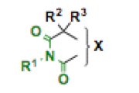
Tool 1- Structure Activity Relationship (SAR) Module
Tab 1: Anticonvulsants SAR Trends:
Ureide common scaffold (in green on compound)
Students can click on each of the drugs below and the compound will be shown (as seen on next page)
Phenobarbital (barbiturate)
Phenytoin (hydantoin)
Fosphenytoin (hydantoin)
Ethosuximide (succinimide)

Slide 56
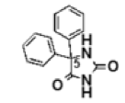
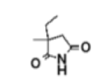
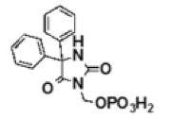
Tool 1- Structure Activity Relationship (SAR) Module
Tab 1: Anticonvulsants SAR Trends: Ureides
Phenobarbital (barbiturate) Phenytoin (hydantoin)
Ethosuximide (succinimide) Fosphenytoin (hydantoin)

Slide 57
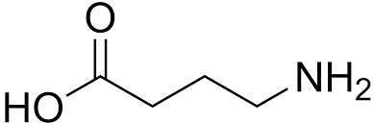
Tool 1- Structure Activity Relationship (SAR) Module
Tab 1: Anticonvulsants SAR Trends:
GABA mimics (GABA structure shown below)
Students can click on each of the drugs below and the compound will be shown (as seen on next page)
Gabapentin
Pregabalin
Valproic acid
Vigabatrin
Tigabine

Slide 58




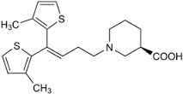
Tool 1- Structure Activity Relationship (SAR) Module
Tab 1: Anticonvulsants SAR Trends: GABA mimics
Gabapentin Pregabalin Valproic acid
Vigabatrin Tiagabine

Slide 59
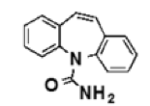
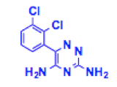

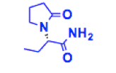
Tool 1- Structure Activity Relationship (SAR) Module
Tab 1: Anticonvulsants SAR Trends: NONE present
Carbamazepine Lamotrigine
Topiramate Levetiracetam

Slide 60
Tool 1- Structure Activity Relationship (SAR) Module
Tab 2: Metabolism Matching
Which of the following compounds induce CYP metabolism?
Click on any compound
CORRECT
CORRECT
CORRECT

Slide 61
Tool 1- Structure Activity Relationship (SAR) Module
Tab 2: Metabolism Matching
Which of the following compounds are NOT metabolized by CYP?
Click on any compound
CORRECT
CORRECT

Slide 62
Tool 1- Structure Activity Relationship (SAR) Module
Tab 3: PRACTICE PROBLEM design: SAR Clinical Case Study
Present a multi-question case with answer choices given as the compound structure
Student can click any of the 3 compounds
If right compound is selected→ explanation of why the answer is correct is shown
If wrong compound is selected→ direct student back to the beginning of the practice problem

Slide 63
Tool 1- Structure Activity Relationship (SAR) Module
Tab 3: PRACTICE PROBLEM: SAR Clinical Case Study
HZ is 45-year old male who has recently been suffering from what is believed to be absence seizures.
Which compound should he be prescribed?
ANSWER: Compound 2 (Ethosuximide); best used for absence seizures

Slide 64
Tool 1- Structure Activity Relationship (SAR) Module
Tab 3: PRACTICE PROBLEM: SAR Clinical Case Study
HZ is 45-year old male who has recently been suffering from what is believed to be absence seizures. Unfortunately, ethosuximide was not effective, and it is decided that HZ needs a medication for partial seizures instead. HZ also is taking several other medications.
Which compound should he take?
ANSWER: Compound 3 (Lamotrigine); not metabolized by CYP and does not induce CYP, which could interfere with other medications

Slide 65
Tool 2
Module Design Overview:
The module will be designed as one screen, that has fill in the blank statements, with a drop down menu of ~4 possible choices. After all are filled in, the student submit for answers/explanations, and print the completed correct copy for their own studying
1. Mechanism of Action/Indication characteristics
Students will have examples of drug structures from the class on the screen and will know what drug class they are working on
The drop down menu will have possible fill in the blank choices
The goal of the fill in the blanks will to have a summary of where and how the drug class acts, and why it works for its indications
2. Side effects/Contraindications
If there are significant side effects or contraindications to specific drugs in the class or to the drug class in general, these can be addressed as well as statements with blanks to be filled in.

Slide 66
Tool 2 examples
Antiepileptic drugs primarily reduce _________ activity or enhance __________ activity
Both blanks: excitatory, inhibitory
_______________ seizures impair consciousness for 30 seconds - 2 minutes
Choices: partial, complex partial, absence
Antiepileptic drugs targeting sodium channels block ____________
Drop down menu options:Sodium efflux, normal action potentials, epileptiform discharges

Slide 67
Tool 2 examples
Ethosuximide acts by inhibiting the activity of _________ channels and is used only for ___________ seizures
First blank: Calcium, Sodium, Chloride, Potassium
Second blank: complex, partial, absence
The anticonvulsant drug__________ is useful for reduce seizures and weight
Blank choices: topiramate, valproic acid, gabapentin
Felbamate is an antiepileptic that blocks _____________ receptors
Choices: AMPA, dopamine, GABA, NMDA

Slide 68
Tool 2 examples
_____________ induces its own metabolism
Choices: Phenytoin, Carbamazepine, Gabapentin
A rare but serious side effect of _______________ is Steven’s Johnson syndrome
Choices: Levetiracetam, Lamotrigine, Carbamazepine
The most common side effect of ____________ and ______________ are dizziness and somnolence.
Both blank options: Gabapentin, Phenytoin, Pregabalin, Phenobarbital

Slide 69
Tool 2 examples
__________ binds to a synaptic vesicle protein and reduces presynaptic neurotransmitter release mediated by Ca2+
Drop down menu options: Levetiracetam, Lamotrigine, topiramate
Carbamazepine can be administered most safely without interaction with ________
Drop down menu options:Lorazepam, phenytoin, diazepam
_______ is an irreversible inhibitor of GABA transaminase
Drop down menu options: Gabapentin, Pregabalin, Valproic acid, vigabatrin

Slide 70
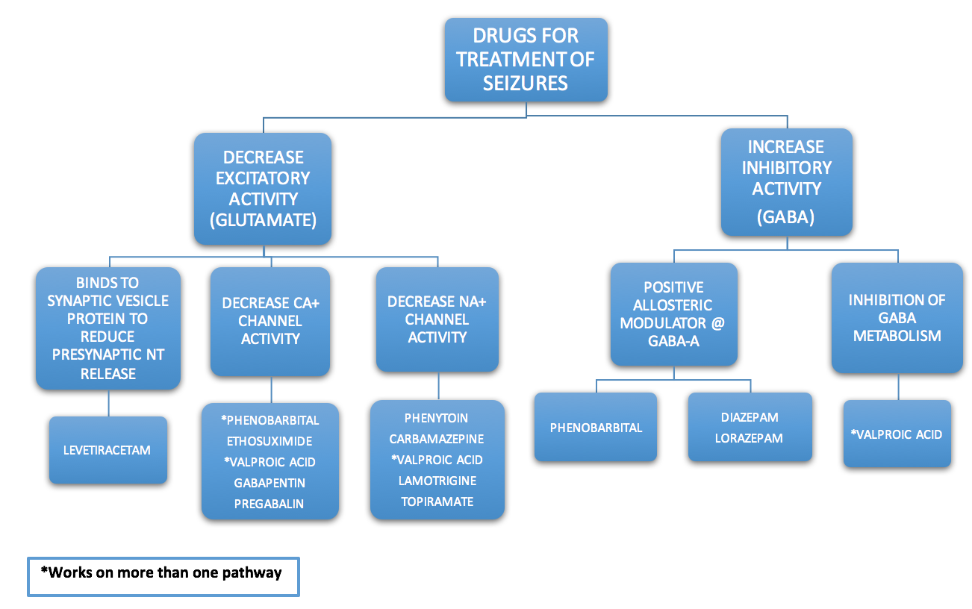
Tool 3 -

Slide 71
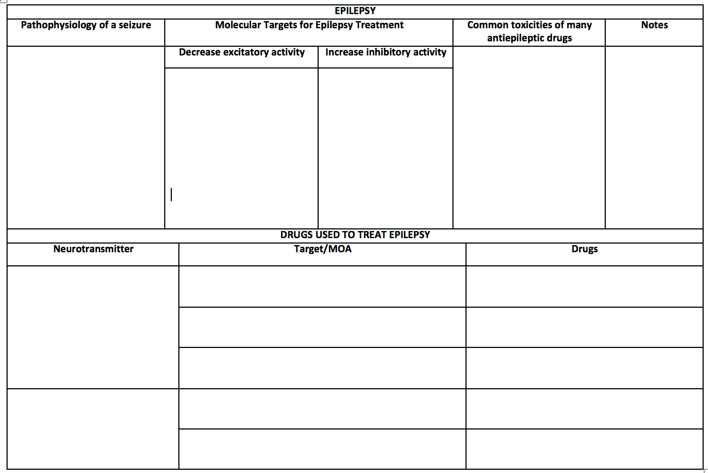
Tool 3 - Blank Antiepileptic worksheet

Slide 72
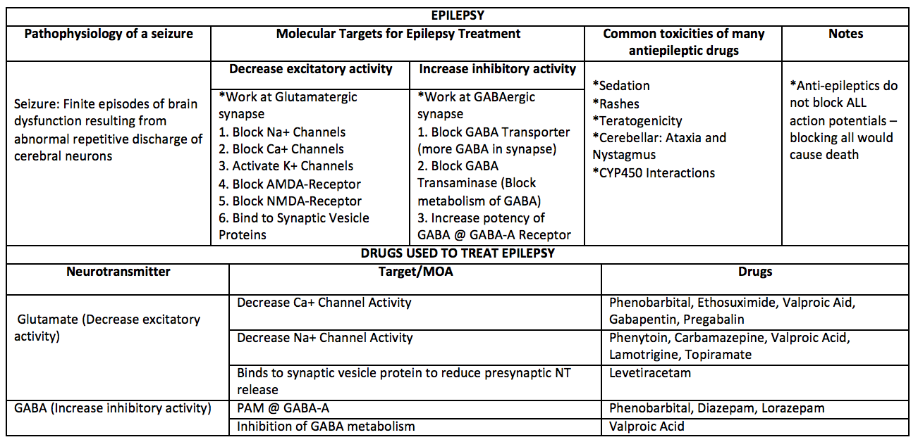
Tool 3 - Complete Antiepileptic worksheet for reference

